Slide 1
La Virgen de Guadalupe
Jenna de Vries
Mini Research Assignment_SEM1
SPAN 308-90
CSUMB
Mr. Adrian Andrade
Spring 2014
February 21st, 2014

Slide 2
.:La Virgen de Guadalupe:.
Brief History / Origin
The “5” hallucinations to Juan Diego
Influence and Importance
Notes:
My topic is about La Virgen de Guadalupe, also famously known as the Virgin Mary. When I saw this name earlier in the readings and apart of concept research tasks, I knew exactly what this was referring to. However, I do not know much about this topic other than its roots in Catholism. So, what I found most interesting is the general knowledge of her placement in the world, how the depictions of Juan Diego came across his visions and how her influence and importance in the Mexican culture has evolved from then until today.

Slide 3
Brief History / Origin
December 9, 1531 – Lady of Guadalupe appears
Virgin Mary – Tonantzin / Catholic derived
Behind the image
Notes:
What I have found out in researching The lady of Guadalupe is that she was first “discovered” or seen on the day of December 9th, 1531 when Juan Diego was on his way to a mass and catechism class in Tlatelolco. As we know, the image of the Lady of Guadalupe is completely and fully from the iconic-resemblance of the Virgin Mary, who comes from the Catholic background. Aside from this fact, at the time of the Spanish Conquest of 1519 to 1521, the lately religiously-crossovered Indians were seen worshiping their new Tonantzin, which more than likely was La Virgen de Guadalupe. What I found really interesting was the means behind the background depicted behind the Lady of Guadalupe. She is to be clothed under the sun and the moon located below her feet. She is also depicted as to have upon her head a crown of twelve stars. Translation is connected to her by her other name known as the Woman of the Apocalypse.

Slide 4
Like “5” of the same dream~
First time > Surprise!
Second time > Report of Failure
Third time > Proof leads to obstacle
Fourth time > Flowers from a Rock?
Fifth time > Healed of death
Notes:
So I have heard that Juan Diego had seen a vision of the Virgin, yet I was mostly interested in how and what he may have saw. Little did I know he saw her not just once, but five times. The first was on his way to a Mass and catechism class. He was walking by Tepeyac Hill when a a bright light caught his attention. Soon after he heard music and a feminine voice call out to him. As he was drowning within her aurora that filled him with immeasurable joy and peace, she had instructed him to go to Mexico city. The second happened due to the Bishop not believing him and upon his return to the hill, she was waiting there for him. The third time Juan needed proof and asked the Mistress for help. She grants his petition only to find out he could not follow through due to the severe illness that fell upon his Uncle. The fourth has Juan on his way to the Bishop to come to his dying Uncle only to be stopped by his vision of the Lady of Guadalupe down by the roadside. Juan had explained his troubles. The Lady had assured him with kindness and confirmation that everything would be well, so that he could continue on the mission he cared to have proof for the Bishop. She instructs him to cut flowers from the top of the hill and take them to him. Eventually, both the Bishop and Juan are in shock by the flowers found to have grown in an area where flowers could not bloom and the flowers taken were among the fabric where niether had put them. The final time is she meets the uncle and heals him of his ailment.

Slide 5
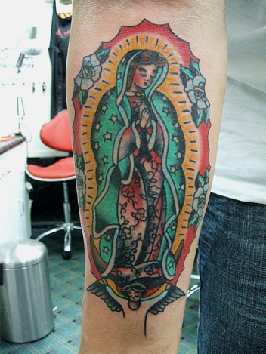
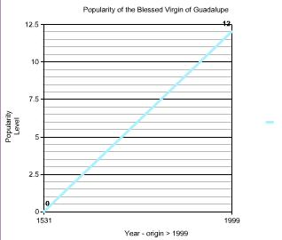
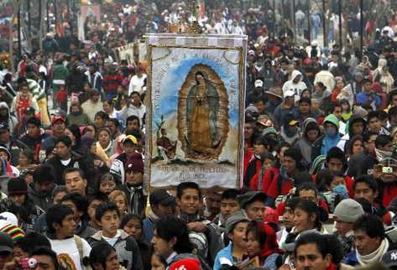
Influence and Importance~
Basilica – Image of the
Lady of Guadalupe
Symbol of Mexico
People’s Belief
Modern Imagery
and movement
Notes:
The image made by Juan Diego visions of La Virgen de Guadalupe is portrayed in the Roman Catholic Church known as the Basilica of Our Lady of Guadalupe. It is said that this Church located on the hill of Tepeyac located in the city of Mexico is the most visited shrine to date. In the year of 1999,a faithful amount of about 12 million people visit the Basilica to pay their time to the Lady of Guadalupe. I am astounded to see such a movement and belief within this woman. Not only has this woman become such an icon for Mexico, yet people believe, just like the materialistic items made of Jesus Christ, the same from this woman’s presence can heal the sick, offer protection from harmful entities, or possess supernatural powers among itself. This image is also seen flooding into movies and tattoos upon people body of a part of people household items or even a person shrine is created within someone’s home. I believe that the history and iconic movement of this woman is both astounding and shocking, basing the facts or ideas on the history one man’s experience leading to a belief system that has influenced a whole culture and tradition.

Slide 6
Bibliography~
Image:
http://upload.wikimedia.org/wikipedia/commons/e/ea/Our_Lady_of_Guadalupe.JPG
http://upload.wikimedia.org/wikipedia/commons/2/2c/Virgen_de_guadalupe1.jpg
http://highlighthollywood.com/wp-content/uploads/2013/11/La_Virgen_De_Guadalupe_Dios_Inantzin_photo_2.jpg
http://librako.files.wordpress.com/2012/12/aparicion-virgen-de-guadalupe.jpg
http://farm8.staticflickr.com/7062/6893959451_825c54c526_z.jpg
http://imagenesdelavirgendeguadalupe.com/wp-content/uploads/2013/07/imagenes-de-la-virgen-de-guadalupe-en-mexico-5.jpg
Information:
http://www.queenoftheamericasguild.org/BriefHistoryNew.html
http://www.latintimes.com/who-virgen-de-guadalupe-brief-history-saint-so-important-mexican-culture-136817
Poole, Stafford. Our Lady of Guadalupe : The Origins and Sources of a Mexican National Symbol, 1531-1797. University of Arizona Press, 1995. Print.
Poole, Stafford. "Our Lady of Guadalupe: An Ambiguous Symbol." Catholic Historical Review, 81.4 (1995): 588.
Rodriguez, Jeanette. Our Lady of Guadalupe: Faith and Empowerment among Mexican-American Women. Austin, University of Texas Press, 1994. Print.

