Slide 1
The Mexican-American War
Jenna de Vries
Mini Research Assignment_SEM2
SPAN 308-90
CSUMB
Mr. Adrian Andrade
Spring 2014
February 28th, 2014
Notes:
Good evening. For my Seminar 2 research presentation, I have the privilege to talk about the Mexican-American war.

Slide 2
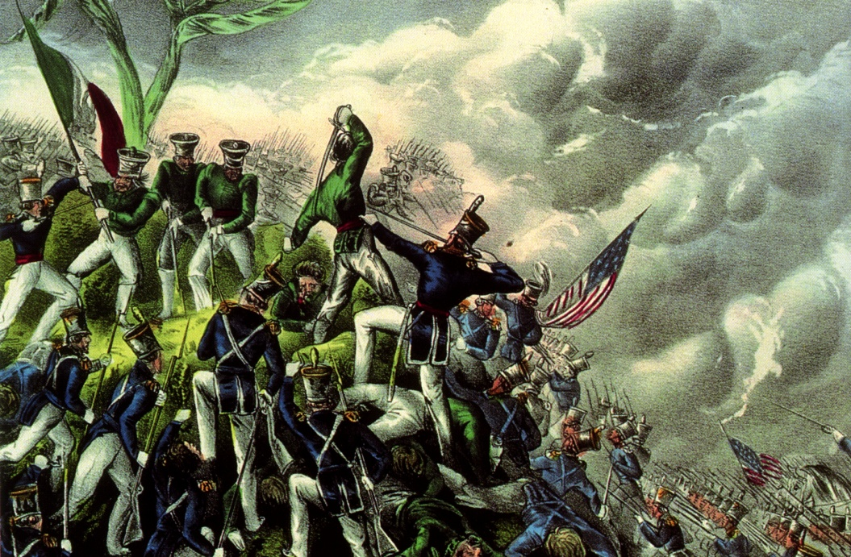
Introduction
The Beginnings of the War of 1847
The Treaty of Guadalupe Hidalgo
The Repercussion
Notes:
For this topic I shall talk about what led to the war, how the war was brought to an end and what had occurred from the results of this war.

Slide 3
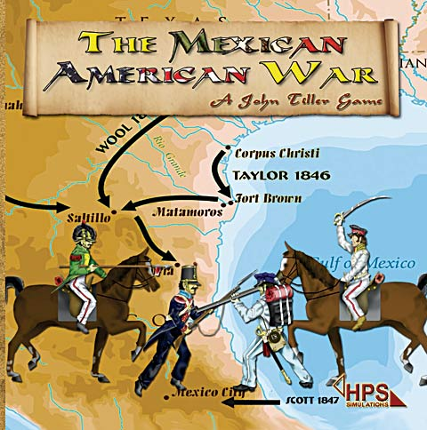
The B.W. 1846-1848
Manifest Destiny
Two main reasons:
Expansion into neighbors territory
Independence of Texas/Annexation
Battle campaigns(highlight):
The Battle of Monterrey
The Battle of Buena Vista
The Victory of Vera Cruz
Notes:
The beginnings of this war had begun with a term called “Manifest Destiny”. All this meant was the idea and action put into effect to expand one territory, apeaking about the Anglo-Saxons A.K.A US territory. This led to the desire to obtain the lands of California, Texas, Arizona and led into wanting New Mexico. The reasons that developed even more into this war was the independence sought from Texas.
As specified in Mr. Gonzales’ book, it consisted of three main campaigns. This included the taking and victory over Monterrey, Buena Vista and Vera Cruz. These were all American derived, claimed by Mr. Gonzales. The movement on Monterrey occurred on September 21, 1846 with General Zachary Taylor at the reins. By the 25th of this same month, the Mexican had retreated and gave the land to the Americans. The battle of Buena Vista had happened on February 23, 1847. This was more on an extra interval battle that led way to the main victorious battle at Vera Cruz, where General Winfield Scott had led the armies. At Buena Vista, the dispute between Gen. Taylor and General Antonio Lopez de Santa Anna went head to head. Gen. Santa Anna had lost a great deal of mean that battle in regards to the loss amount Gen. Taylor had lost.
The most important conquest happened on March 28, 1847. Vera Cruz is a vital Mexican port and stronghold within Mexico, at that time. In the end, this place was surrendered to the American forces and served as a supply base for the duration of the Mexican-American war.

Slide 4
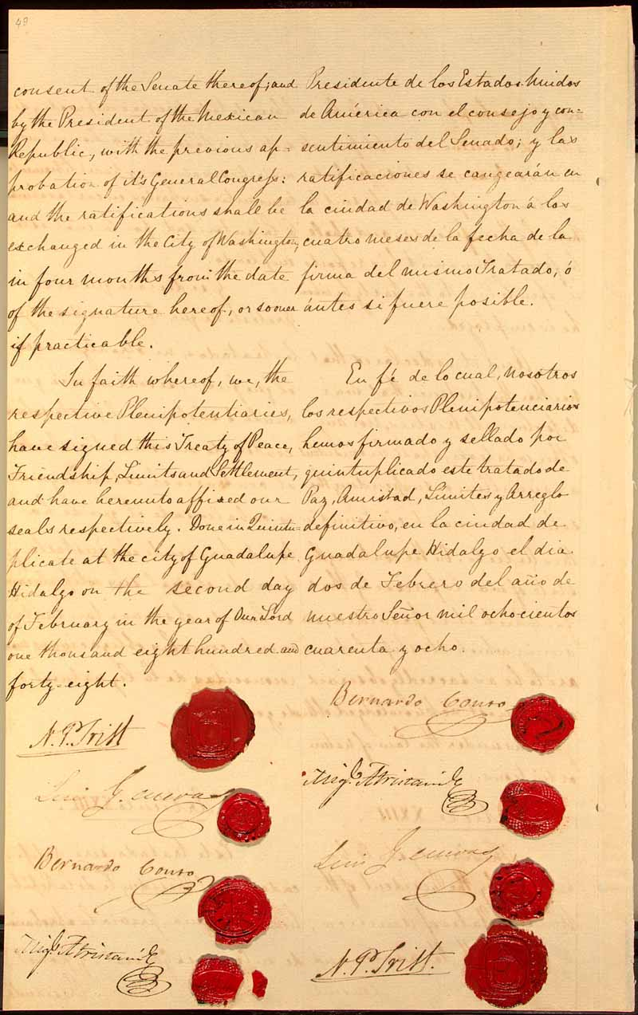
The Treaty of Guadalupe Hidalgo
The Purpose and Results
The treaty that so-called
ended the war
“End of Deal” compensations
Annexation of northern parts of
Mexico
“Blood” money
Notes:
It was only then by the Treaty of Guadalupe Hidalgo was this war brought to a finish. It was signed on February 2, 1848 yet ratified by the US Senate (by votes of 38-14) on March 10, 1848. This treaty entailed that the US owned the lands that went on for Arizona, California, Texas(the Rio Grande) and the utmost Northern parts of New Mexico. However, according to Gonzales’ studies, the Mexicans were given a option to pack their things and leave more south or remain in the now American Southwest. They were given all the rights of that of the United States’ citizen, this included the free enjoyment for their freedom and success in financial or economical wealth. However, for the damage done to the Mexican ground and its people, the US paid up to $18 million , whether to compensate or for Mexican debts to the United States’ citizens. Either way…this all seemed like nothing more than blood money due to some studies stating that the war had cost US over $100 million and one to many lives lost for the gain of land.

Slide 5
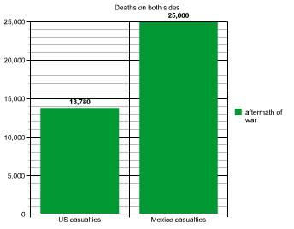
The Reprocussion
Loss of land
Loss of “freedom”- dictated peace
Statistics of death, on each side
US casualties
Mexican casualties
Notes:
As it is analyzed that Mexico lost so much land and freedom through this war. Many argue that the treaty played more of a tool to dictate peace rather than come to terms on an understanding of equalized peace where lives did not have to be lost or taken. In regards to life, The US lost up to 13,780 lives, while the Mexicans lost up to 25,000 lives and 2/3 of their land.
As for today, there may even still be racial distance and domination between such cultures and its people. A question rises to when opportunity presents itself to gain what does not belong yet must be obtained, how much “more” can we afford to lose until the object is belonging to just one?

Slide 6
References
Images
www.nps.gov
www.hpssims.com
www.loc.gov
Graph made by self - http://nces.ed.gov/NCESKIDS/createagraph/default.aspx
Links/Resources
http://www.history.com/topics/mexican-american-war
http://www.pbs.org/kera/usmexicanwar/aftermath/
http://www.historyguy.com/Mexican-American_War.html#.UzZB6IXLKpo
Gonzales, Manuel G. Mexicanos: A History of Mexicans in the United States. Bloomington: Indiana UP, 1999. Print.

